Slide 1

SYSTEM DATABASES

Slide 2
Objective
Types of System Databases
Optional Databases

Slide 3
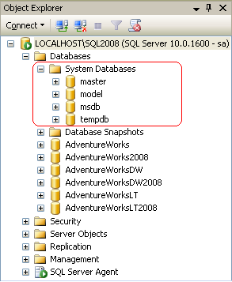
System Databases
Master
Model
MSDB
Tempdb
Resource
Notes:
All the System databases are Instance specific. One cannot drop any of these System Databases.

Slide 4
Master
Records
All the system level information
Instance-wide metadata
Existence of all other databases including the Locations
Initialization information for SQL Server
Notes:
Master database records the initialization information for SQL Server. Therefore, SQL Server cannot start if the master database is unavailable.

Slide 5
Tempdb
It is a global resource
Holds
Temporary user objects
Intermediate result sets
Re-created every time SQL Server starts
Cannot take backup of Tempdb
Notes:
Tempdb is available to all users connected to the particular instance of SQL Server. Tempdb is re-created every time SQL Server is started so that the system always starts with a clean copy of the database. Temporary tables and stored procedures are dropped automatically on disconnect, and no connections are active when the system is shut down. Therefore, there is never anything in Tempdb to be saved from one session of SQL Server to another. Backup and restore operations are not allowed in tempdb.

Slide 6
Model
Applied as the template for all databases created on the instance of SQL Server
Model database must always exist on a SQL Server system
The default is user configurable
Notes:
Some of the settings of model are also used for creating a new Tempdb during start up, so the model database must always exist on a SQL Server system. If you modify the model database, all databases created afterward will inherit those changes.

Slide 7
MSDB
Used by SQL Server Agent for scheduling alerts and jobs
Holds information about Backup and Restore history. This information includes
The name of the party that performed the backup
The time of the backup
The devices or files where the backup is stored

Slide 8
Resource
Hidden database
Read-only database that contains copies of all System objects

Slide 9
Optional Databases
ReportServerDb:
Used by Reporting Services
Stores all properties, objects, and metadata in a SQL Server database
Stored data includes published reports, compiled reports, report models

Slide 10
Summary
Without MasterDb SQL Server will not start
TempDb is created every time SQL Server starts
ModelDb acts as a template
MSDB is used to schedule jobs
Cannot drop any of these System Databases

